Slide 1

Year Round Stewardship
Notes:
Before we can talk about Year Round Stewardship, we need to know what Stewardship is. I know this is going to make some of the finance people in the room have a heart attack, but – Stewardship is NOT about the budget. Budgets are a real and necessary part of the world, but when hearts are open to understanding then the budget will take care of itself. God will get us where He wants us to go if we are open to it. So what is Stewardship? (get responses from audience)
Everything I have is a gift from God. Everything. Stewardship is using the gifts God has given me to do the work God is calling me to do.

Slide 2
Why Year Round Stewardship
Stewardship is what we do with all that God has given us, all the time – Not the “annual beg-a-thon”
Takes stewardship out of the "annual occurrence" category and places it where it should be - right in front of us, all year round.
Strengthens and supports members of the congregation in their knowledge and understanding of their roles as God’s stewards
Develop and strengthen stewardship theology in the parish
Changes the culture by changing the conversation in non threatening ways
Notes:
Why is Year Round Stewardship important?
Stewardship is what we do with all that God has given us, all the time – Not the “annual beg-a-thon”
Takes stewardship out of the "annual occurrence" category and places it where it should be - right in front of us, all year round.
Strengthens and supports members of the congregation in their knowledge and understanding of their roles as God’s stewards
Develop and strengthen stewardship theology in the parish
Changes the culture by changing the conversation in non-threatening ways
Who should be involved with Stewardship? (Wait for responses) Clergy & Lay Leadership, Adults, Youth, Children…
EVERYONE!

Slide 3
Who Should Be Involved?
Leaders
Adults
Youth
Children
Notes:
Who should be involved with Stewardship? (Wait for responses) Clergy & Lay Leadership, Adults, Youth, Children…
EVERYONE!

Slide 4
Clergy & Leadership
Don’t tell me you’re trusting God until you trust Him with your pocketbook.
J. Vernon McGee
Notes:
Let’s start with the hardest group – Clergy and Leadership. When leadership doesn't lead, the group depending on leadership doesn't make progress. This is an essential truth for us as we encourage generosity for the purpose of doing God's work in the world. So how do we – as clergy and lay leadership – lead in regards to stewardship?

Slide 5
“It is difficult for leaders to lead where they have never gone or are afraid to venture” Melvin Amerson
Preach it, Preacher!
Vestry Stewardship Statement
We believe God is the source of all gifts, spiritual and material. Our faithful response, in gratitude, is to be givers and creators our­selves. While we strive to be good stewards of all God's gifts to us, we believe that the way we use our money reflects the state of our spiritual lives.
We commit to follow Christ in community. In prayerful witness to our faith, each of us is already tithing or is committed to working towards the tithe.
Our experience is that joyful giving results in spiritual growth. We invite the parish to join us in this commitment to deepening our faith.
Notes:
Preach it, Preacher! Clergy, incorporate stewardship into your sermons all year – not just in the weeks preceding your annual campaign. Avoiding talking about the spiritual practice of stewardship from the pulpit is doing a disservice to God and the congregation. Sometimes the lectionary lends itself to an entire sermon on stewardship –in which case, don’t avoid it! – but even if your entire sermon isn’t on stewardship, most Sundays at least a few lines about stewardship are easy to work in.
Vestry Stewardship Statement As leaders, how can you ask the congregation to do something that you haven’t even really spent much time considering?
A vestry stewardship statement is developed during a workshop with the help of a facilitator. (Consultants from the Commission on Stewardship are available.) With Bible study and some serious discernment, we develop a comprehensive 3-part statement that everyone has to agree on: We Believe…, We Commit…, We Invite… Then you frame it, put it on the wall, and publish it.
Example: We believe God is the source of all gifts, spiritual and material. Our faithful response, in gratitude, is to be givers and creators our­selves. While we strive to be good stewards of all God's gifts to us, we believe that the way we use our money reflects the state of our spiritual lives.
We commit to follow Christ in community. In prayerful witness to our faith, each of us is already tithing or is committed to working towards the tithe.
Our experience is that joyful giving results in spiritual growth. We invite the parish to join us in this commitment to deepening our faith.
Developing a vestry stewardship statement not only facilitates the members of your vestry getting clear about what they believe as individuals and as a leadership body, but it also gives the vestry a vehicle to offer public reflection about how each person experiences God in the midst of financial decision making.
Monthly Article in Newsletter
Doesn’t have to be “heavy”. Stewardship, the word, comes from the Old English term sty-ward and reflects the practice of appointing reliable workers to be wardens of the pig sty; thus, sty-wards. “From The Pig’s Sty”
Sunday Bulletin
Financial Updates
Quotes
Cartoons
Thank You Notes
Most underutilized tool we have. We underestimate the power of a thank you note.
Vestry thank you notes – one (or more) per month to a parishioner acknowledging their service.
Once per month from team leaders.
Clergy – list of every person involved in ministry, write 4-8/mo check them off the list
Saying Thank You is being a good steward of one of your most valuable resources

Slide 6
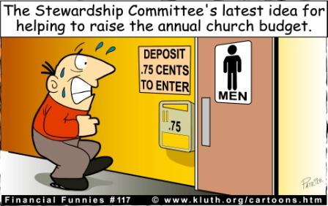
“It is difficult for leaders to lead where they have never gone or are afraid to venture” Melvin Amerson
Monthly Article in Newsletter
Stewardship, the word, comes from the Old English term sty-ward and reflects the practice of appointing reliable workers to be wardens of the pig sty; thus, sty-wards. “From The Pig’s Sty”
Sunday Bulletin
Financial Updates
Quotes
Cartoons
Thank You Notes
Notes:
Preach it, Preacher! Clergy, incorporate stewardship into your sermons all year – not just in the weeks preceding your annual campaign. Avoiding talking about the spiritual practice of stewardship from the pulpit is doing a disservice to God and the congregation. Sometimes the lectionary lends itself to an entire sermon on stewardship –in which case, don’t avoid it! – but even if your entire sermon isn’t on stewardship, most Sundays at least a few lines about stewardship are easy to work in.
Vestry Stewardship Statement As leaders, how can you ask the congregation to do something that you haven’t even really spent much time considering?
A vestry stewardship statement is developed during a workshop with the help of a facilitator. (Consultants from the Commission on Stewardship are available.) With Bible study and some serious discernment, we develop a comprehensive 3-part statement that everyone has to agree on: We Believe…, We Commit…, We Invite… Then you frame it, put it on the wall, and publish it.
Example: We believe God is the source of all gifts, spiritual and material. Our faithful response, in gratitude, is to be givers and creators our­selves. While we strive to be good stewards of all God's gifts to us, we believe that the way we use our money reflects the state of our spiritual lives.
We commit to follow Christ in community. In prayerful witness to our faith, each of us is already tithing or is committed to increasing his or her personal giving to reach or exceed the tithe.
Our experience is that joyful giving results in spiritual growth. We invite the parish to join us in this commitment to deepening our faith.
Developing a vestry stewardship statement not only facilitates the members of your vestry getting clear about what they believe as individuals and as a leadership body, but it also gives the vestry a vehicle to offer public reflection about how each person experiences God in the midst of financial decision making.
Monthly Article in Newsletter
Doesn’t have to be “heavy”. Stewardship, the word, comes from the Old English term sty-ward and reflects the practice of appointing reliable workers to be wardens of the pig sty; thus, sty-wards. “From The Pig’s Sty”
Sunday Bulletin
Financial Updates
Quotes
Cartoons
Thank You Notes
Most underutilized tool we have. We underestimate the power of a thank you note.
Vestry thank you notes – one (or more) per month to a parishioner acknowledging their service.
Once per month from team leaders.
Clergy – list of every person involved in ministry, write 4-8/mo check them off the list
Saying Thank You is being a good steward of one of your most valuable resources

Slide 7
Children
Train up a child in the way he should go: and when he is old, he will not depart from it.
Proverbs 22:6
Notes:
We did the hardest group; now let us look at the easiest group – Children.

Slide 8
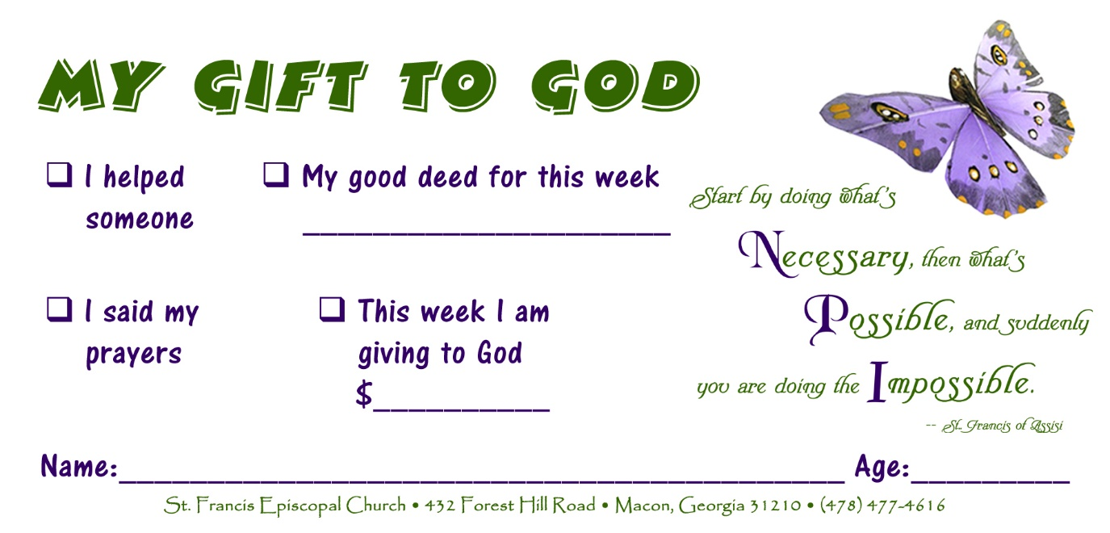
Children’s Giving Envelopes
Notes:
Children’s offering envelopes –
Can buy 100 online for $3.99 or make your own.
Always include time and talent with money.
Make available in Sunday school classes and narthex – keeps stewardship in daily conversation

Slide 9
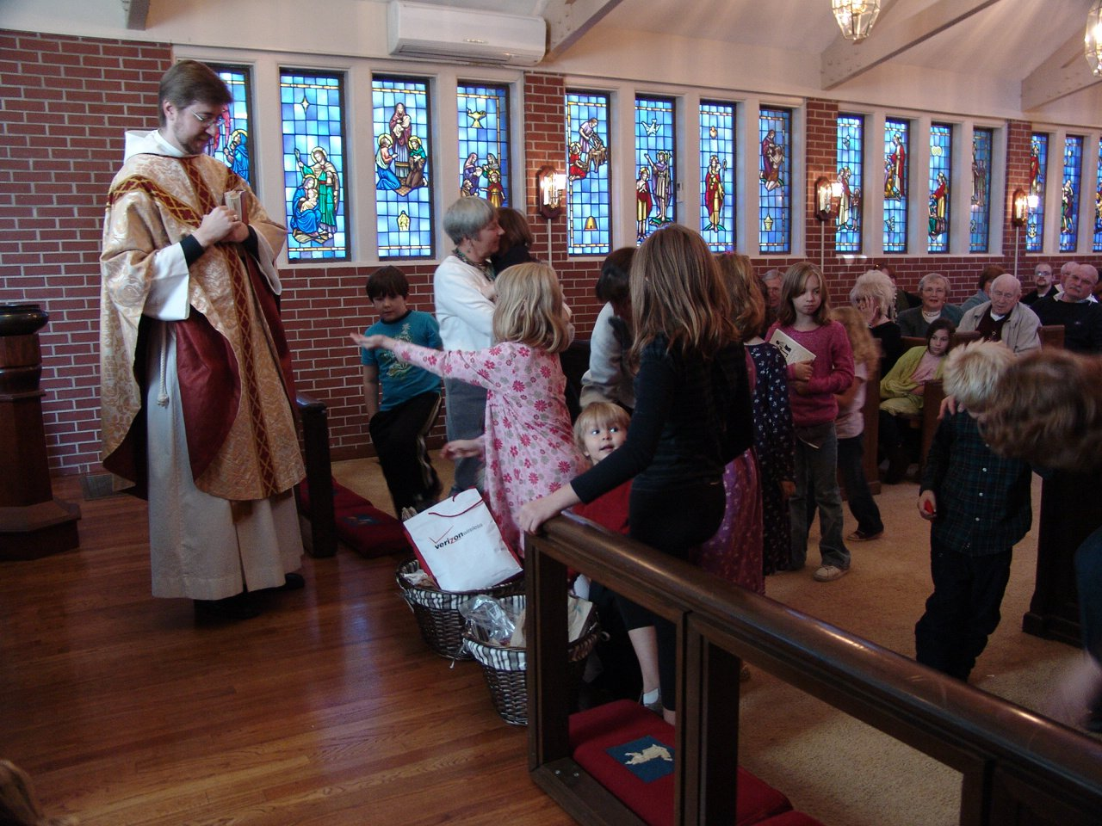
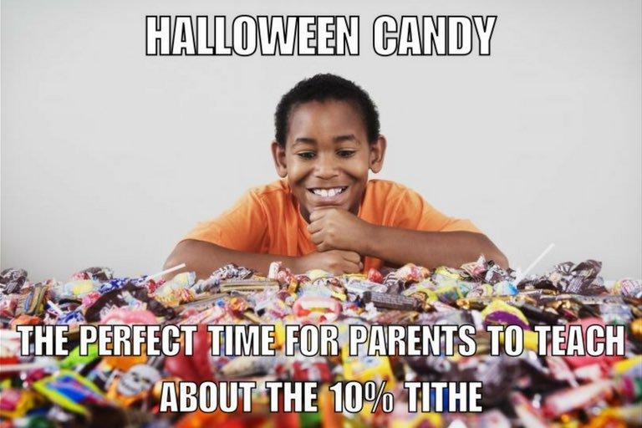
Candy Tithe
Notes:
Candy Tithe
Candy is as close to currency as you can get in children.
Have children bring 10% of their Halloween candy to the altar the Sunday following Halloween and donate it to homeless shelter or other organization.
Story of Libby – wined and complained for weeks before Halloween about the candy tithe. Halloween night mom helped her separate out 10% of the candy. “Wait? That’s it? Really?! Oh, that’s not enough.” Voluntarily gave more than her tithe. Tangible, lifelong lesson about tithing.

Slide 10
Youth
Let no one despise you for your youth, but set the believers an example in speech, in conduct, in love, in faith, in purity.
1 Timothy 4:12
Notes:
Youth
Most teenagers inherently understand stewardship. We just need to provide them with the language to articulate what they already believe as “stewardship”.

Slide 11
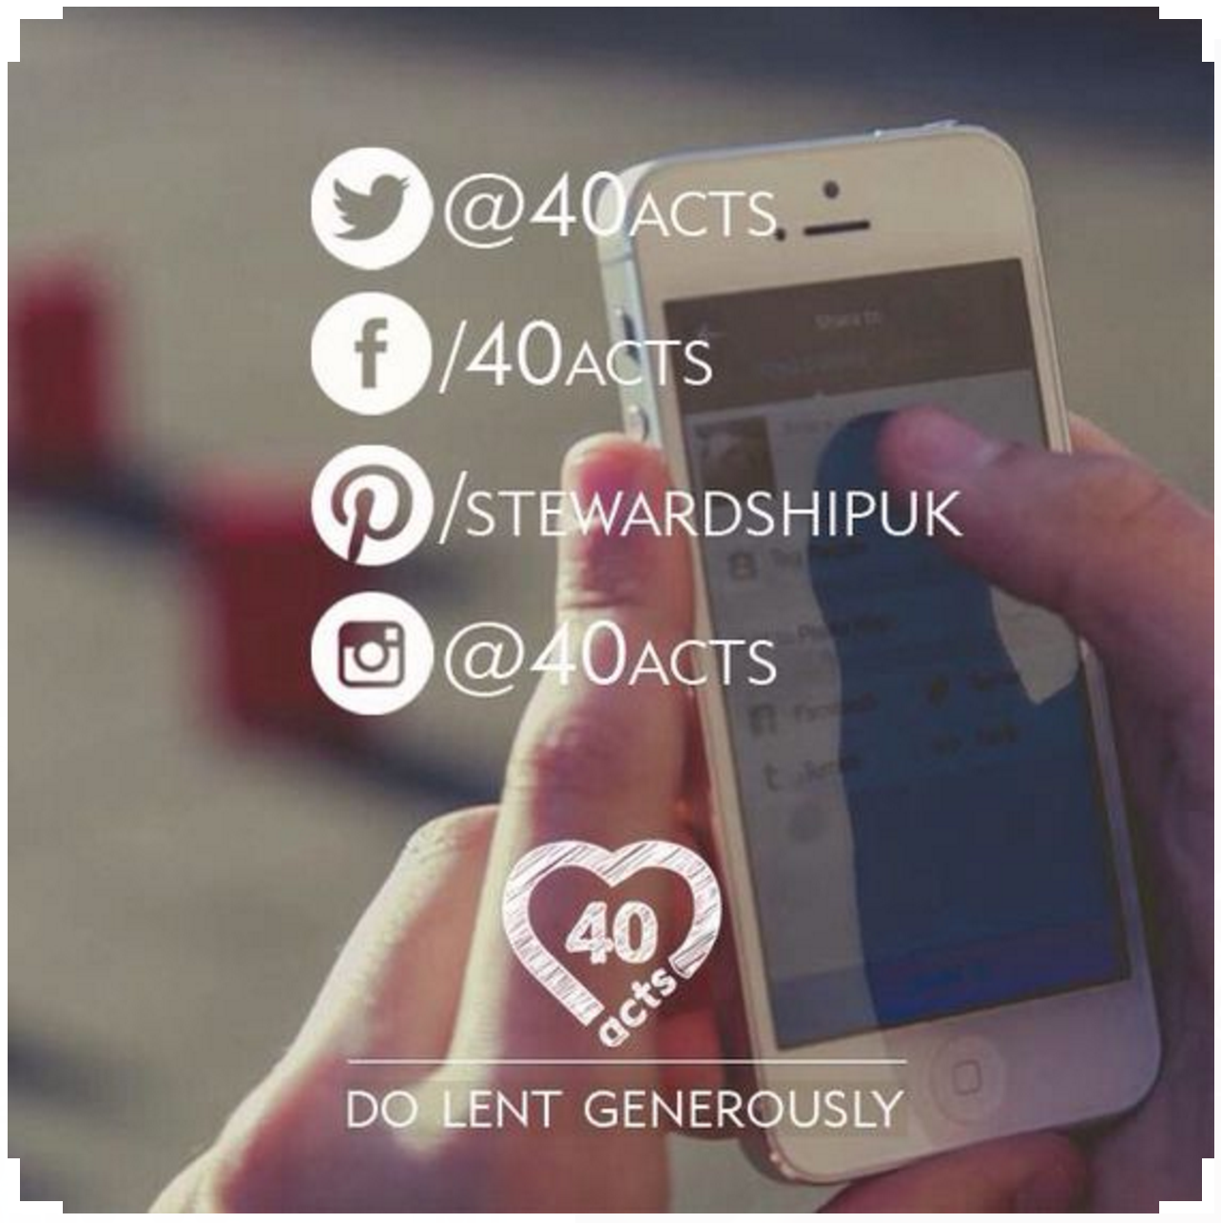

40 Days, 40 Acts of Generosity:
40 days of giving back, doing good and living generously
Notes:
40 Acts: Do Lent Generously – 40 DAYS, 40 ACTS OF GENEROSITY: 40 days of giving back, doing good and living generously
The online challenge encourages people to make generosity and kindness a habit. It is not only about money, but also being generous with your time, words and hugs! It is focused on doing this not only for friends and family but for strangers too.
Story from Starbucks: At a drive through a driver decided to pay for the coffee of the driver behind them. This continued for two and a half hours!
Sign up online at www.40act.org/uk
Get an email each day of Lent with an inspiring daily reflection, a prayer, and 3 levels of challenge: Green, Amber, Red. Green is the easiest level, which are the quickest and usually free ideas. Amber, ‘a little more challenging than green, taking no longer than 15 min or less’. And Red, ‘for those who love to push themselves!’
Social media component as well
Can sign up as an individual or group
In addition to daily emails, also has resource materials for doing 40Acts as a high school youth group, middle school youth group, children’s Sunday school, adult Sunday school, family, and small groups.
Strongly encourage this for the ENTIRE parish – can be very unifying, but it is particularly appealing to the youth because of social media component.

Slide 12
Everyone
Now is our time to go. To go into the world to share the good news of God and Jesus Christ. To go into the world and help to be agents and instruments of God’s reconciliation. To go into the world, let the world know that there is a God who loves us, a God who will not let us go, and that that love can set us all free.
This is the Jesus Movement, and we are The Episcopal Church, the Episcopal branch of Jesus’ movement in this world.
- Presiding Bishop Michael Curry

Slide 13
Make Stewardship An Everyday Word
Recycling – Thanks for practicing good stewardship!
Incorporate the term into meetings – Instead of “What should we spend our budget on?” try “How can we be the best stewards of these resources?” or when considering a purchase, “Is this practicing good stewardship?”
Province I: “Turn the lights off, for God’s sake” – Because reducing energy use is an act of stewardship both of God’s good creation and of financial resources.
Notes:
Make Stewardship and everyday word
Recycling – Thanks for being a good steward of our resources!
Incorporate the term into meetings – Instead of “What should we spend our budget on?” try “How can we be the best stewards of these resources?”
Instead of “Please turn off the lights”, “Please practice good stewardship by turning off the lights!”
Province 1 (New England) has a campaign called “Turn the lights off, for God’s sake” because “reducing energy use is an act of stewardship both of God’s good Creation and of financial resources”

Slide 14
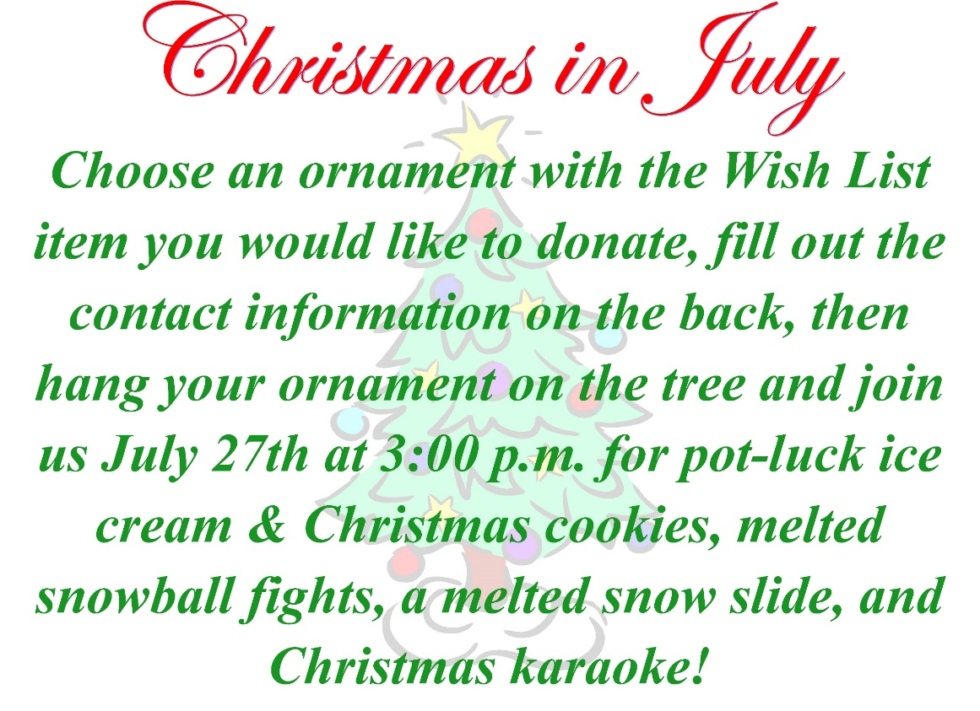
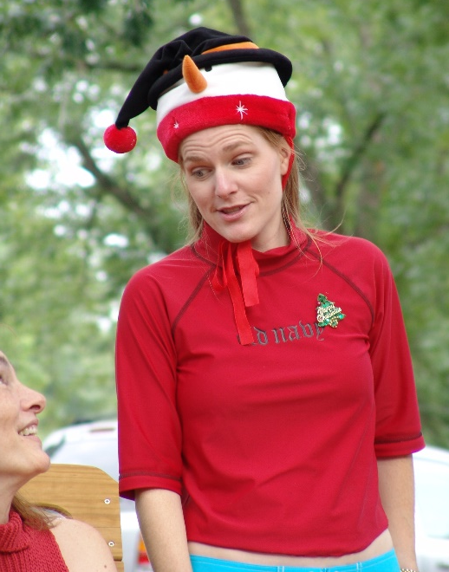
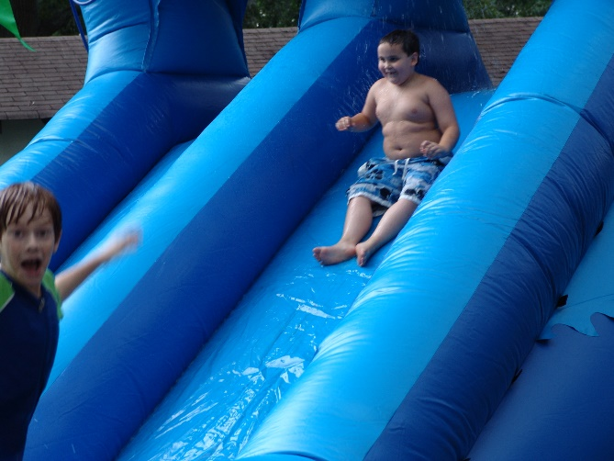
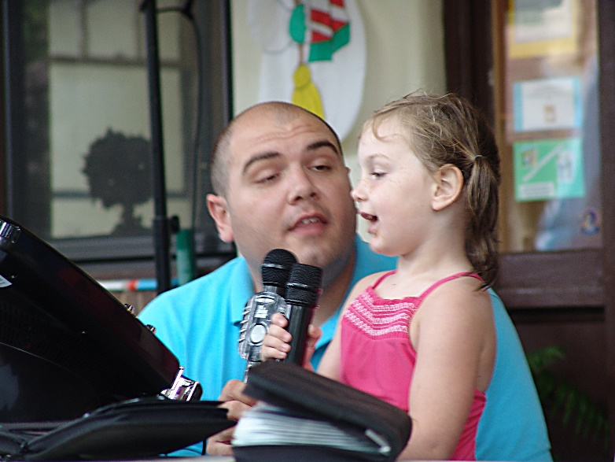
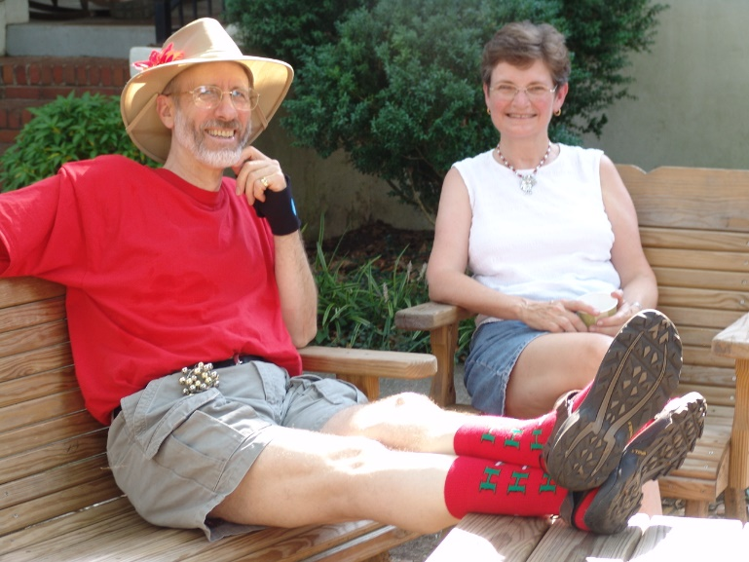
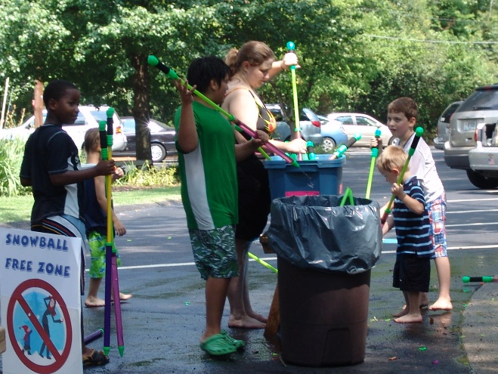
FUN Events – Not Just Annual Campaign
Notes:
Fun events – not just annual campaign
Christmas in July
Santa is on vacation, we have to step up.
Have each ministry team make a “wish list” – include tasks, big and small items (elevator/matches)
Post wish list in parish hall
Tree with lights no ornaments
Children make ornaments, but can only be hung on tree when someone takes an item off the wish list and writes it on the ornament
Day of event –
Pot luck ice cream and Christmas cookies
Christmas karaoke on the porch
Melted snow slide (aka water slide)
Melted snow ball fights (aka water balloons)
Gets everyone involved, creates church wide bonding through fellowship, gets much needed items for ministries (our sacristy won’t have to buy silver polish for years!), and, most importantly, gets people to think of stewardship in a new (positive) way.

Slide 15
Year Round Stewardship Calendar
Based on work by the Diocese of West Texas
Notes:
In a well-executed stewardship program, there is something planned for stewardship every month. Does that sound overwhelming? It doesn’t have to be – Honest! The Diocese of West Texas developed a great framework for a year round stewardship calendar. We started with their basic framework, then customized and expanded it for the Diocese of Atlanta.
The calendar gives congregations suggestions and resources for practicing year ‘round stewardship.
Each month, the church season is explained
And a theme is identified around which individual and congregational activities might take place in five recurring categories:

Slide 16
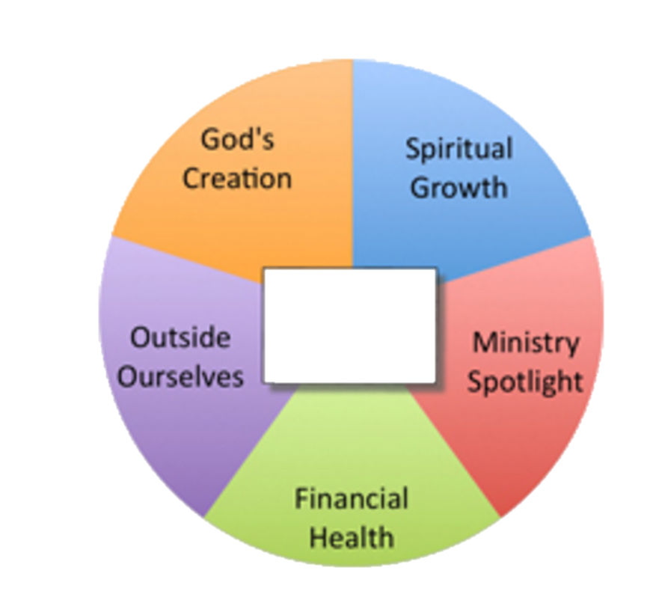

Spiritual Growth
Offers ways to deepen the spiritual lives of individuals and the congregation.
Ministry Spotlight
Focusing on a different ministry each month is a way of giving thanks for that ministry and raising awareness about it to attract new participants. Encourages saying “thank you”.
Financial Health
Offers focus on fiscal responsibility, can communicate leadership’s good
stewardship of the congregations resources. Also offers many ways families can
be intentional about how they manage their money including what they are saving and what percentage of their income they are giving away.
Outside Ourselves
In outreach we take our stewardship to the streets of our communities. These activities help people connect their pledge to ministry; in addition, communicating and celebrating the stories of meeting the needs of people are important motivators for personal stewardship decisions.
God’s Creation
How we care for the environment that God has entrusted to us is a mark of our faithfulness. This category can include caring for the environment in our communities, in our homes, and in our churches.
Notes:
Spiritual Growth – Offers ways to deepen the spiritual lives of individuals and the congregation.
Ministry Spotlight – Focusing on a different ministry each month is a way of giving thanks for that ministry and raising awareness about it to attract new participants. Encourages saying “thank you”.
Financial Health – Offers focus on fiscal responsibility, can communicate leadership’s good stewardship of the congregations resources. Also offers many ways families can be intentional about how they manage their money including what they are saving and what percentage of their income they are giving away.
Outside Ourselves – In outreach we take our stewardship to the streets of our communities. These activities help people connect their pledge to ministry; in addition, communicating and celebrating the stories of meeting the needs of people are important motivators for personal stewardship decisions.
God’s Creation – How we care for the environment that God has entrusted to us is a mark of our faithfulness. This category can include caring for the environment in our communities, in our homes, and in our churches.

Slide 17
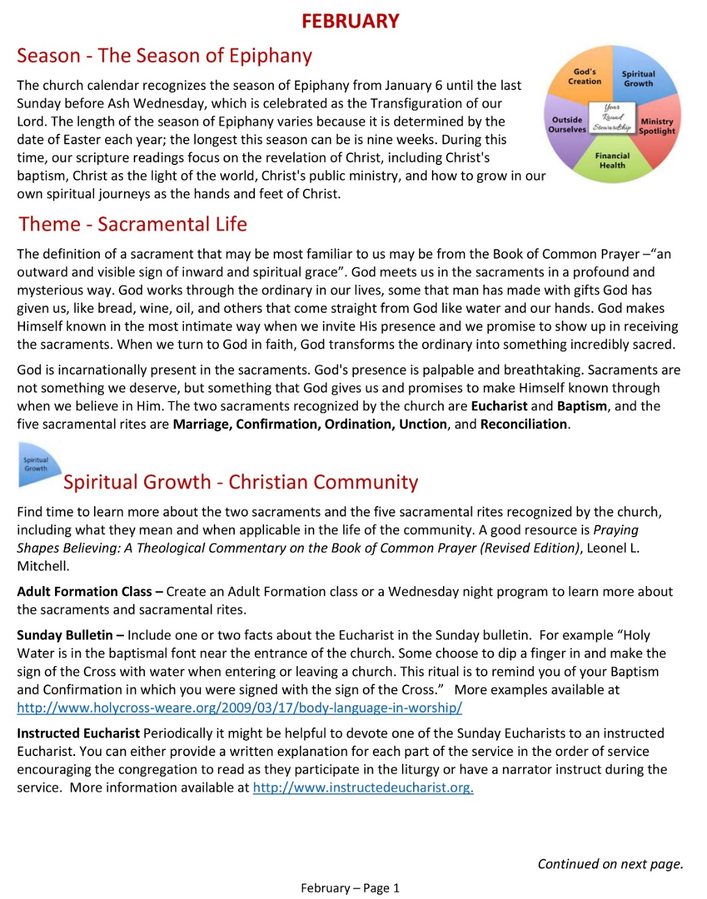
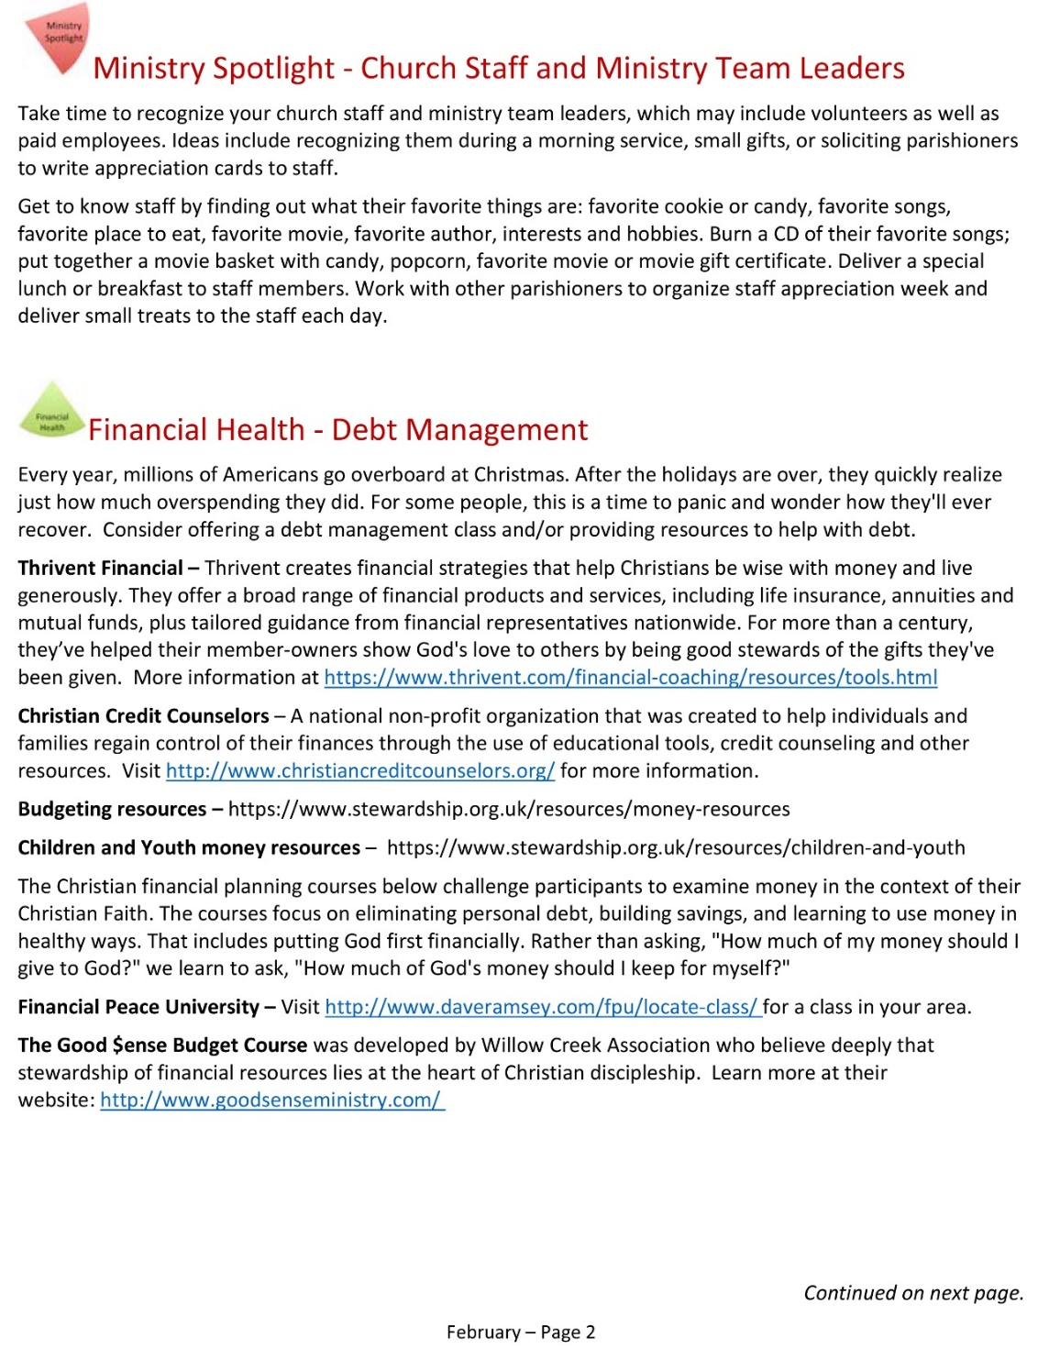
Notes:
For example, this is the planning guide for February. As you can see, the month has information about the liturgical season and a theme. Then there are several suggestions for Spiritual Growth, Ministry Spotlight, Financial Health….

Slide 18
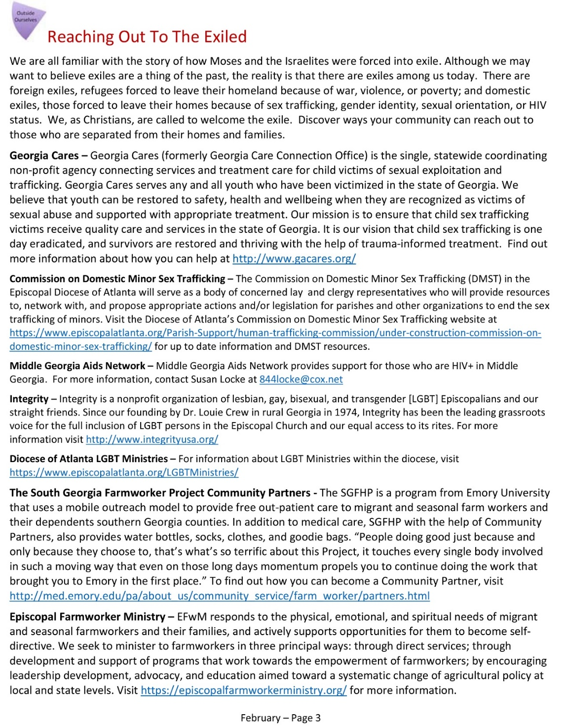
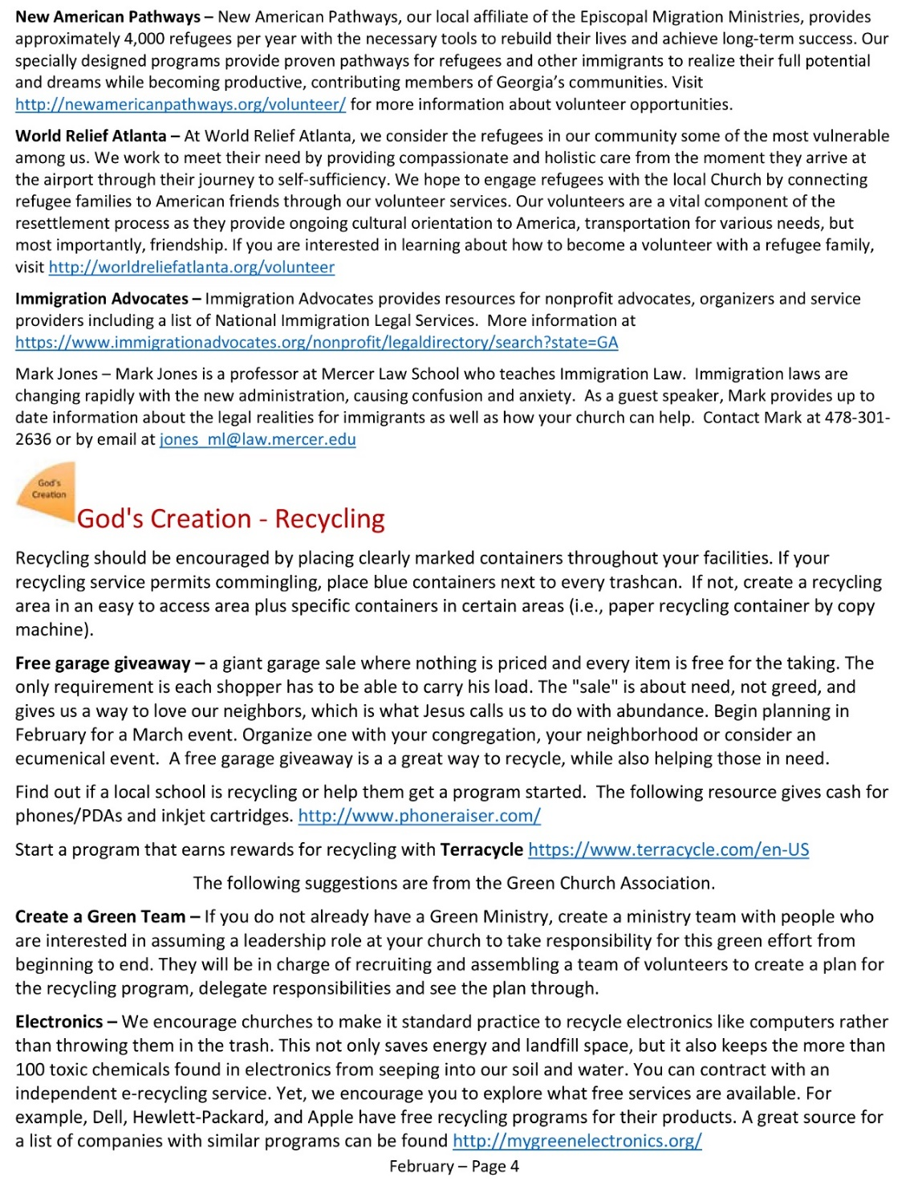
Notes:
Outside Ourselves, and God’s Creation.

Slide 19
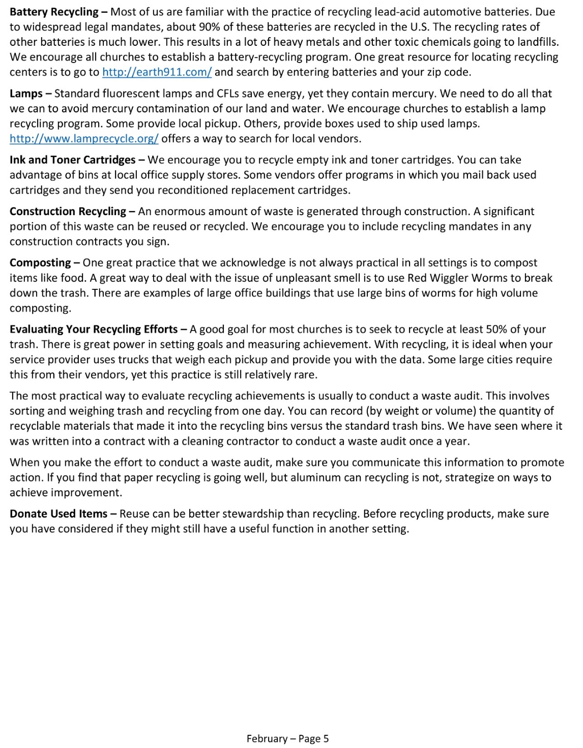
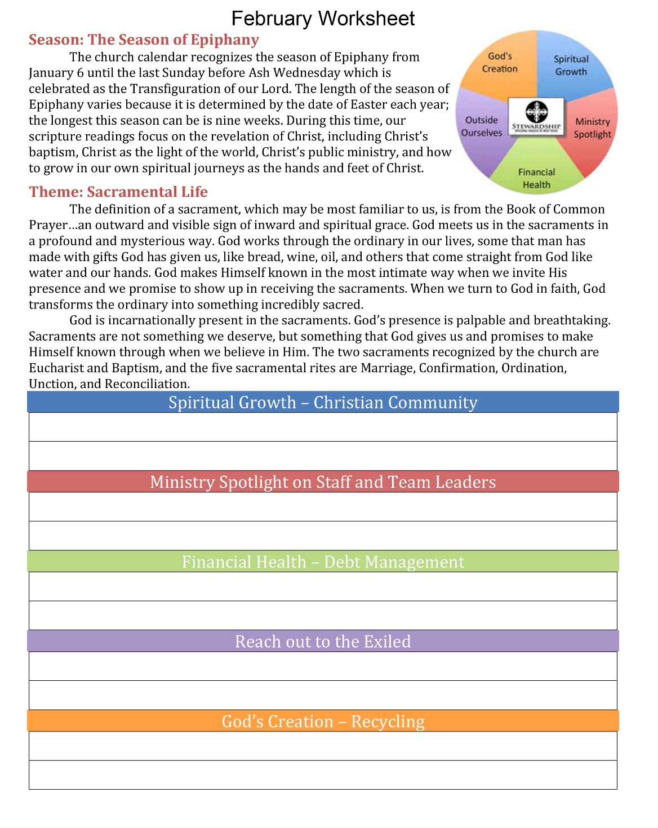
Notes:
In addition to the planning guide, there is a worksheet like this one for every month.
Remember – This calendar is a starting point, tailor ideas for your congregation

Slide 20
Tips for Execution
Complete each of the five areas on the worksheets
Start with 5 options.
Execute as many as you can do well
Ministry Spotlight takes minimal time
Get other ministries involved
Spiritual Growth – Partner with Worship Committee and/or Adult Christian Formation Committee
Outside Ourselves – Partner with Outreach
God’s Creation – Partner with Green Team/Creation Keepers
Notes:
Activity – Time to put the rubber to the road and get to work!
Work in teams of at least 2 people
Senior Wardens – Assign each month
Complete your assigned month’s worksheet with a plan for each of the five areas
As a leadership body - Review each month’s plans, elicit feedback, and make any necessary changes.
Be creative! Don’t be limited by what is on the worksheet, add new ideas.
Prepare to share your ideas. (time permitting)

Slide 21
Group Activity: Develop Your Year Round Stewardship Plan
Senior Wardens – Assign each month
Complete your assigned month’s worksheet with a plan for each of the five areas
Junior Wardens – Collect completed worksheets
As a leadership body - Review each month’s plans, elicit feedback, and make any necessary changes.
Be creative!
Notes:
Activity – Time to put the rubber to the road and get to work!
Work in teams of at least 2 people
Senior Wardens – Assign each month
Complete your assigned month’s worksheet with a plan for each of the five areas
As a leadership body - Review each month’s plans, elicit feedback, and make any necessary changes.
Be creative! Don’t be limited by what is on the worksheet, add new ideas.
Prepare to share your ideas. (time permitting)

Slide 22

Questions? Thoughts? Comments?
All scripture is inspired by God and is useful for teaching, for reproof, for correction, and for training in righteousness, so that everyone who belongs to God may be proficient, equipped for every good work.
2 Timothy 3:16-17
Notes:
Any final thoughts or questions?
Year Round stewardship doesn’t have to be hard or complicated
We are here to help you.

Slide 23
Tammy Pallot tammypallot@gmail.com (478) 954-5441
All scripture is inspired by God and is useful for teaching, for reproof, for correction, and for training in righteousness, so that everyone who belongs to God may be proficient, equipped for every good work.
2 Timothy 3:16-17

